Slide 1
Algorithmics - Introduction -

Slide 2
Contents
What is an Algorithm?
What are the Characteristics of an Algorithm?
How to write an Algorithm?
Time to Practice

Slide 3
What is an Algorithm?

Slide 4

What is an Algorithm?
Algorithm is a step-by-step procedure, which defines a set of instructions to be executed in a certain order to resolve a problem. Algorithms are generally independent from any programming languages, so an algorithm can be implemented in more than one programming language.

Slide 5
Simple Algorithm Example
Problem: I’m working on my laptop in the office and I want to make a coffee.
Algorithm:
Step 1: Stand up from your chair.
Step 2: Take my mug.
Step 3: Go to coffee machine
Step 4: Put the mug;
Step 5: Press on the button on desired type of coffee
Step 6 : Take my coffee
Step 7: Go back to my place
Step 8: Drink coffee

Slide 6
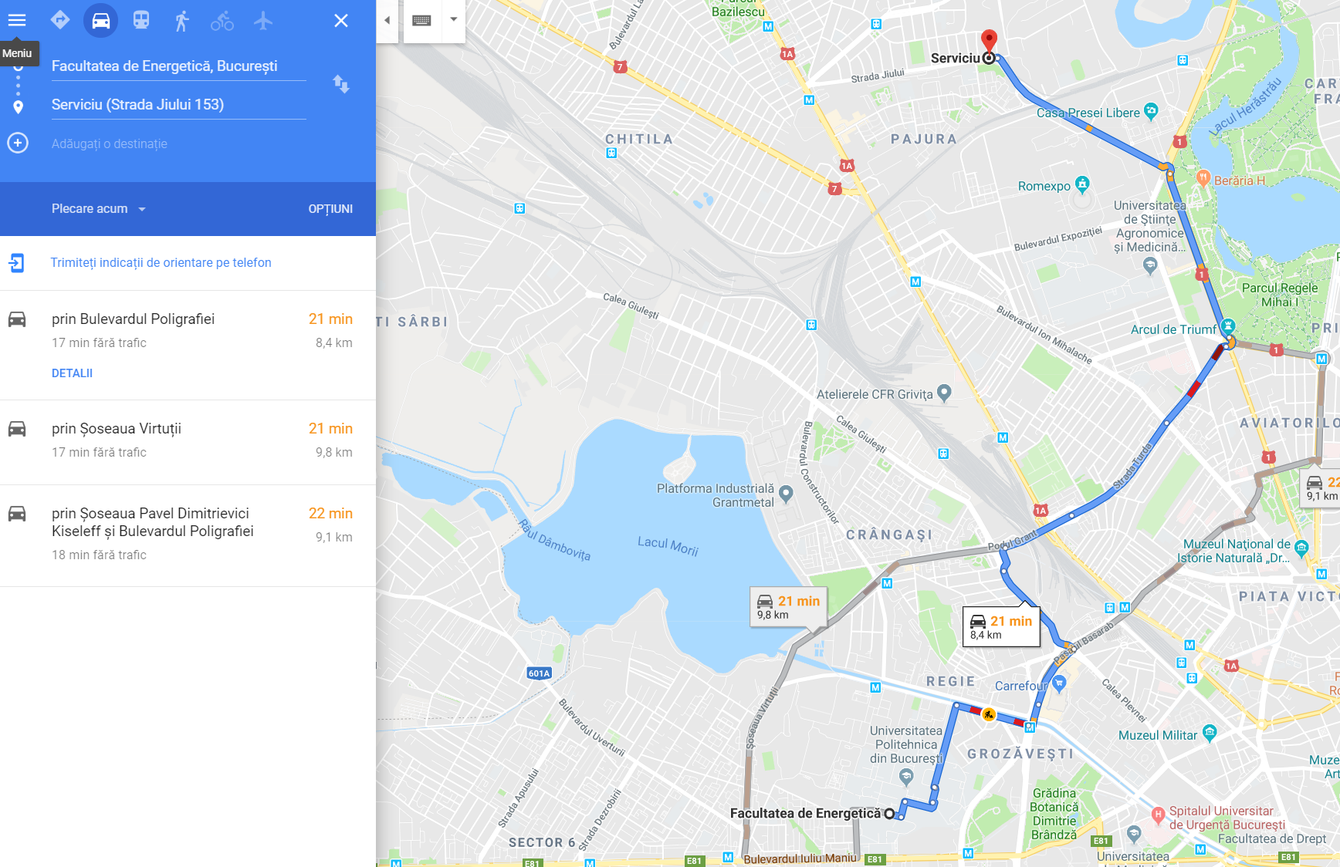
Famous Algorithm Example
How does Google Maps calculate how to get from our office to UPB ?
They use route calculation algorithm

Slide 7
What are the Characteristics of an Algorithm?

Slide 8
What are the characteristics of Algorithms
Not all procedures can be called an algorithm. An algorithm should have the following characteristics:
Precise: Algorithm should be clear and precise. Each of its steps (or phases), and their inputs/outputs should be clear and must lead to only one meaning.
Input and Output : An algorithm should have 0 or more well-defined inputs and should have 1 or more well-defined outputs.
Finiteness: Algorithms must terminate after a finite number of steps.

Slide 9
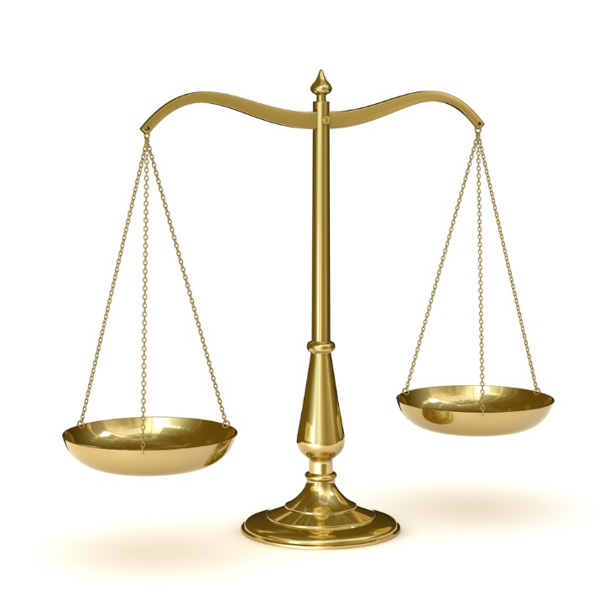


Algorithm Complexity
Usually, the efficiency or running time of an algorithm is stated as a function relating to :
Time complexity − Represents the amount of time required by the algorithm to run to completion.
Space complexity − Represents the amount of memory space required by the algorithm in its life cycle.

Slide 10
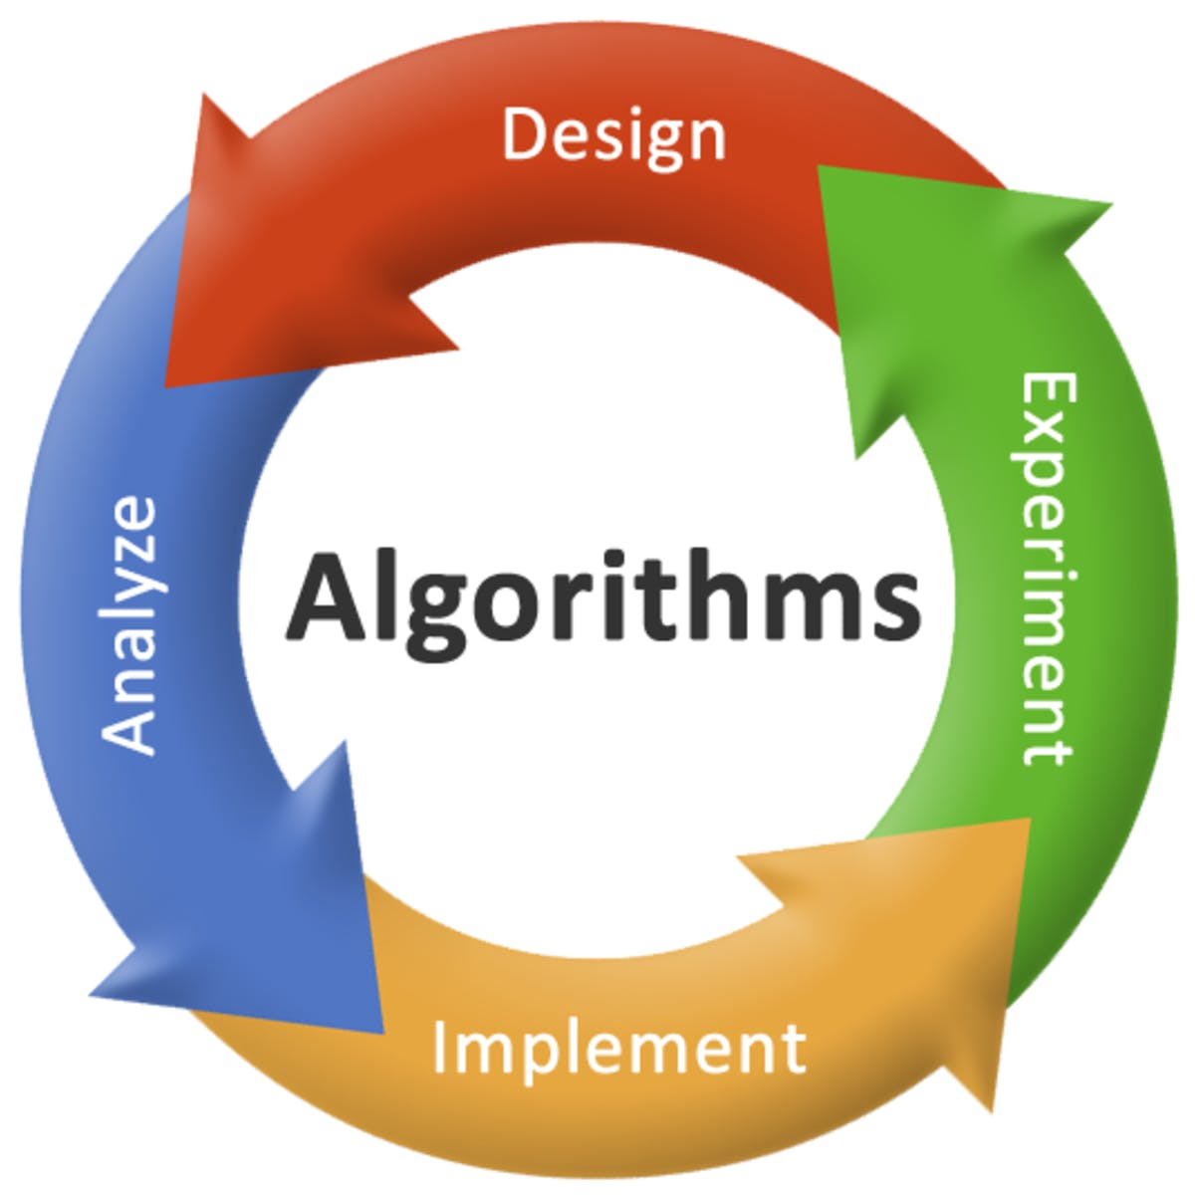
Algorithm Lifecycle
Those are the 4 steps of an Algorithm Implementation

Slide 11
Algorithm Design
The important aspects of algorithm design include creating an efficient algorithm to solve a problem in an efficient way using minimum time and space.
To solve a problem, different approaches can be followed. Some of them can be efficient with respect to time consumption, whereas other approaches may be memory efficient. However, one has to keep in mind that both time consumption and memory usage cannot be optimized simultaneously. If we require an algorithm to run in lesser time, we have to invest in more memory and if we require an algorithm to run with lesser memory, we need to have more time.

Slide 12
Algorithm Analysis
Efficiency of an algorithm can be analyzed at two different stages, before implementation and after implementation. They are the following :
A Priori Analysis − This is a theoretical analysis of an algorithm. Efficiency of an algorithm is measured by assuming that all other factors, for example, processor speed, are constant and have no effect on the implementation.
A Posterior Analysis − This is an empirical analysis of an algorithm. The selected algorithm is implemented using programming language. This is then executed on target computer machine. In this analysis, actual statistics like running time and space required, are collected.
In an industry, we cannot perform A Posterior analysis as the software is generally made for an anonymous user, which runs it on a system different from those present in the industry.
In A Priori, it is the reason that we use asymptotic notations to determine time and space complexity as they change from computer to computer; however, asymptotically they are the same.

Slide 13
Algorithm Analysis
Algorithms are often quite different from one another, though the objective of these algorithms are the same. For example, we know that a set of numbers can be sorted using different algorithms. Number of comparisons performed by one algorithm may vary with others for the same input. Hence, time complexity of those algorithms may differ. At the same time, we need to calculate the memory space required by each algorithm.
Analysis of algorithm is the process of analyzing the problem-solving capability of the algorithm in terms of the time and size required (the size of memory for storage while implementation). However, the main concern of analysis of algorithms is the required time or performance.

Slide 14
Algorithm Analysis
Generally, we perform the following types of analysis
Best case − The minimum number of steps taken on any instance of size a.
Average case − An average number of steps taken on any instance of size a.
Worst case − The maximum number of steps taken on any instance of size a.

Slide 15
Algorithm Analysis: Example
Problem: I’m working on my laptop in the office and I want to make a coffee.
Best case:
Step 1: Stand up from your chair.
Step 2: Take my mug.
Step 3: Go to coffee machine
Step 4: Put the mug;
Step 5: Press on the button on desired type of coffee
Step 6 : Take my coffee
Step 7: Go back to my place
Step 8: Drink coffee
Average case :
Step 1: Stand up from your chair.
Step 2: Take my mug.
Step 3: Go to coffee machine
Step 4: Put the mug;
Step 5: Press on the button on desired type of coffee
Step 6: If coffee is missing then add coffee
Step 7: If water is missing then add water
Step 8 : Take my coffee
Step 9: Go back to my place
Step 10: Drink coffee
Worst case :
Step 1: Stand up from your chair.
Step 2: Take my mug.
Step 3: Go to coffee machine
Step 4: Put the mug;
Step 5: Press on the button on desired type of coffee
Step 6 : If Coffee Machine is broken then call a service for repair to schedule the repair
Step 7: Wait for repair
Step 8: After it’s repaired and delivered put it on it’s place
Step 9: If coffee is missing then add coffee
Step 10: If water is missing then add water
Step 11 : Take my coffee
Step 12: Go back to my place
Step 13: Drink coffee

Slide 16
How to Write an Algorithm?

Slide 17
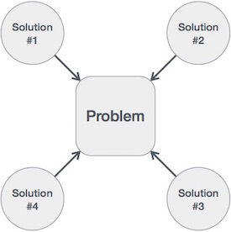
How to Write an Algorithm?
There are no well-defined standards for writing algorithms. Rather, it is problem and resource dependent.
We write algorithms in a step-by-step manner, but it is not always the case. Algorithm writing is a process and is executed after the problem domain is well-defined. That is, we should know the problem domain, for which we are designing a solution.
We design an algorithm to get a solution of a given problem. A problem can be solved in more than one ways.

Slide 18

Algorithm Flowchart
A flowchart is a blueprint that pictorially represents the algorithm and its steps. The steps of a flowchart do not have a specific size and shape rather it is designed in different shapes and sizes (see the image given below).
As shown in the above image, the boxes in different shapes and interconnected with arrows, are logically making a flow chart. A flow-chart represents the general steps in a process.

Slide 19
Benefits of Flowchart
Let us now discuss the benefits of a flowchart.
Simplify the Logic
As it provides the pictorial representation of the steps; therefore, it simplifies the logic and subsequent steps.
Makes Communication Better
Because of having easily understandable pictorial logic and steps, it is a better and simple way of representation.
Effective Analysis
Once the flow-chart is prepared, it becomes very simple to analyze the problem in an effective way.
Useful in Coding
The flow-chart also helps in coding process efficiently, as it gives directions on what to do, when to do, and where to do. It makes the work easier.
Proper Testing
Further, flowchart also helps in finding the error (if any) in program
Applicable Documentation
Last but not the least, a flowchart also helps in preparing the proper document (once the codes are written).

Slide 20







Flow-Chart Symbols
The following table illustrates the symbols along with their names (used in a flow-chart) their names
Symbol | Symbol Name | Purpose
 | Start/Stop | Used at the beginning and end of the algorithm to show start and end of the program.
 | Process | Indicates processes like mathematical operations.
 | Input/ Output | Used for denoting program inputs and outputs.
 | Decision | Stands for decision statements in a program, where answer is usually Yes or No.
 | Arrow | Shows relationships between different shapes.
 | On-page Connector | Connects two or more parts of a flowchart, which are on the same page.
 | Off-page Connector | Connects two parts of a flowchart which are spread over different pages.
Guidelines for Developing Flowcharts
These are some points to keep in mind while developing a flowchart:
Flowchart can have only one start and one stop symbol
On-page connectors are referenced using numbers
Off-page connectors are referenced using alphabets
General flow of processes is top to bottom or left to right
Arrows should not cross each other

Slide 21
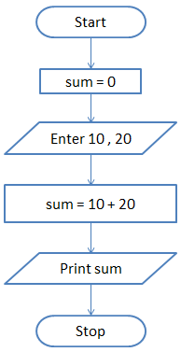
Flow-Chart Examples
Here is a flowchart to calculate the sum of two numbers:

Slide 22
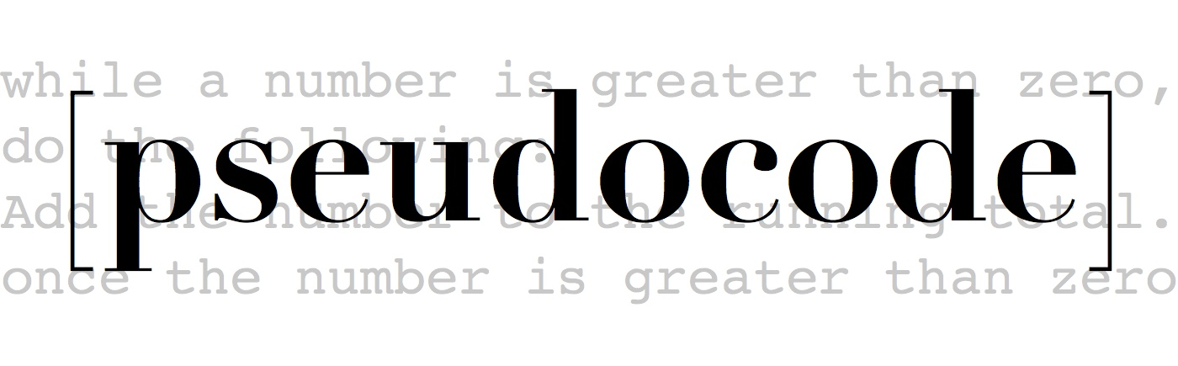
Pseudocode
Pseudocode is an informal way of programming description that does not require any strict programming language syntax. It is used for creating an outline or a rough draft of a program. Pseudocode summarizes a program’s flow, but excludes underlying details.

Slide 23
Difference between Algorithm and Pseudocode
An algorithm is a formal definition with some specific characteristics that describes a process, which could be executed by a computer machine to perform a specific task. Generally, the word "algorithm" can be used to describe any high level task in computer science.
On the other hand, pseudocode is an informal and (often rudimentary) human readable description of an algorithm leaving many granular details of it. Writing a pseudocode has no restriction of styles and its only objective is to describe the high level steps of algorithm in a much realistic manner in natural language.

Slide 24
Difference between Algorithm and Pseudocode: Example
Problem − Design an algorithm and a pseudocode to add two numbers and display the result.
Algorithm:
Step 1 − START
Step 2 − declare three integers a, b & c
Step 3 − define values of a & b
Step 4 − add values of a & b
Step 5 − store output of step 4 to c
Step 6 − Display c
Step 7 − STOP
Pseudocode:
Data: a, b, c type number
C = a + b
Display C.

Slide 25
Time to Practice

Slide 26
Time to Practice: Homework
Problem − Design an algorithm and a pseudocode to calculate the average sum of N numbers.
Algorithm:
Pseudocode:

Slide 27
Additional Materials
Algorithms:
https://www.youtube.com/watch?v=6hfOvs8pY1k
Algorithms: Sorting
https://www.youtube.com/watch?v=rL8X2mlNHPM&t=279s

